Slide 1


CSE211
Computer Organization and Design
Lecture : 3
Tutorial: 1
Practical: 0
Credit: 4

Slide 2
Unit 1 : Basics of Digital Electronics
Introduction
Logic Gates
Flip Flops
Multiplexers
Demultiplexer
Binary counters
Decoder
Encoder
Registers

Slide 3
BINARY-COUNTERS
Binary counters are used for counting the number of pulses coming at the input line in a specified time period.
The binary counters must possess memory since it has to remember its past states.
As the name suggests, it is a circuit which counts.The main purpose of the counter is to record the number of occurrence of some input.

Slide 4
BINARY-COUNTERS
A binary counter is a hardware circuit that is made out of a series of flip-flops.
The output of one flip-flop is sent to the input of the next flip-flop in the series.
A binary counter can be either asynchronous or synchronous, depending on how the flip-flops are connected together.

Slide 5
BINARY-DECODER
The name “Decoder” means to translate or decode coded information from one format into another, so a digital decoder transforms a set of digital input signals into an equivalent decimal code at its output.
In digital electronics, a binary decoder is a combinational logic circuit that converts binary information from the n coded inputs to a maximum of 2^{n} unique outputs.
They are used in a wide variety of applications,
data demultiplexing,
seven segment displays, and
memory address decoding

Slide 6
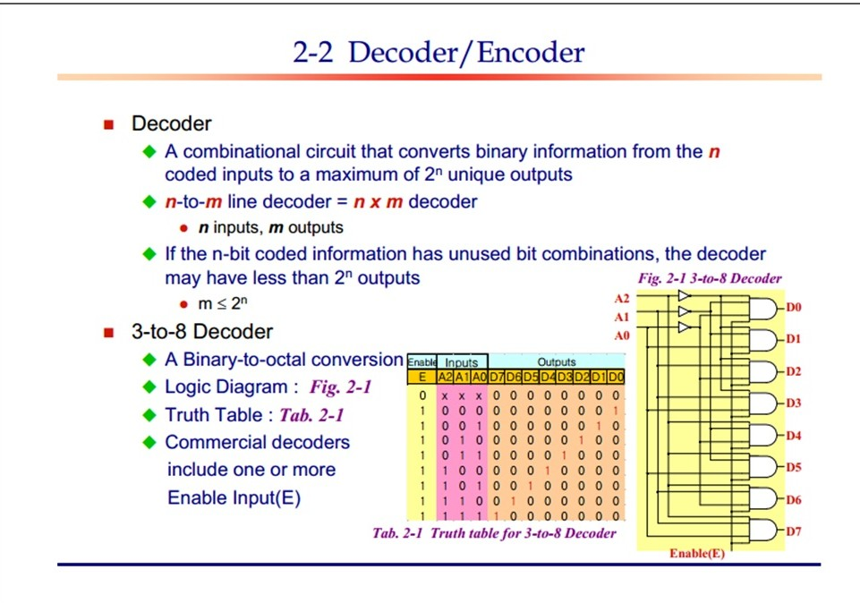

Slide 7
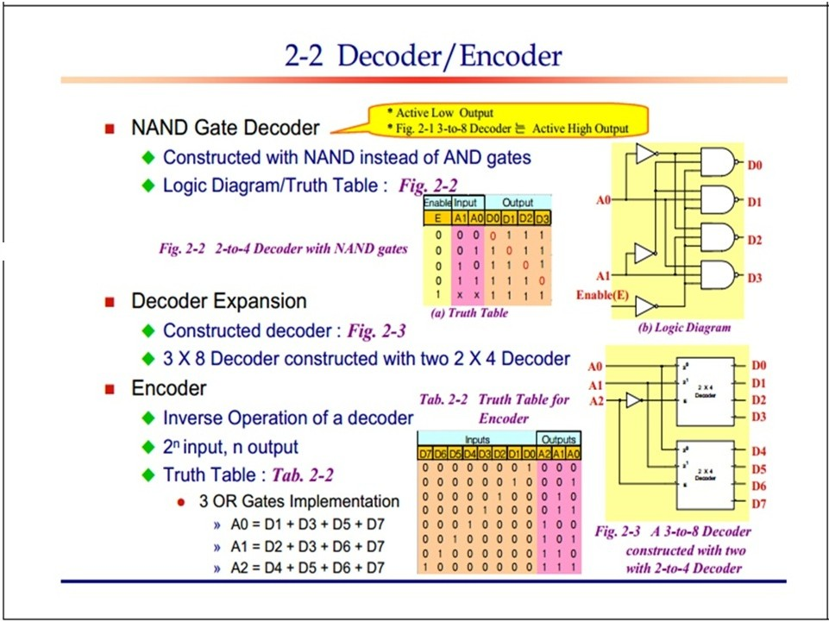

Slide 8

Octal to Binary Encoder
D₇ | D₆ | D₅ | D₄ | D₃ | D₂ | D₁ | D₀ | A₂ | A₁ | A₀
0 | 0 | 0 | 0 | 0 | 0 | 0 | 1 | 0 | 0 | 0
0 | 0 | 0 | 0 | 0 | 0 | 1 | 0 | 0 | 0 | 1
0 | 0 | 0 | 0 | 0 | 1 | 0 | 0 | 0 | 1 | 0
0 | 0 | 0 | 0 | 1 | 0 | 0 | 0 | 0 | 1 | 1
0 | 0 | 0 | 1 | 0 | 0 | 0 | 0 | 1 | 0 | 0
0 | 0 | 1 | 0 | 0 | 0 | 0 | 0 | 1 | 0 | 1
0 | 1 | 0 | 0 | 0 | 0 | 0 | 0 | 1 | 1 | 0
1 | 0 | 0 | 0 | 0 | 0 | 0 | 0 | 1 | 1 | 1
D₁
A₀
D
2
A₁
D₃
D
4
A₂
A₀ = D₁ + D₃ + D₅ + D₇
D₅
D₆
A₁ = D₂ + D₃ + D₆ + D₇
D₇
A₂ = D₄ + D₅ + D₆ + D₇

Slide 9
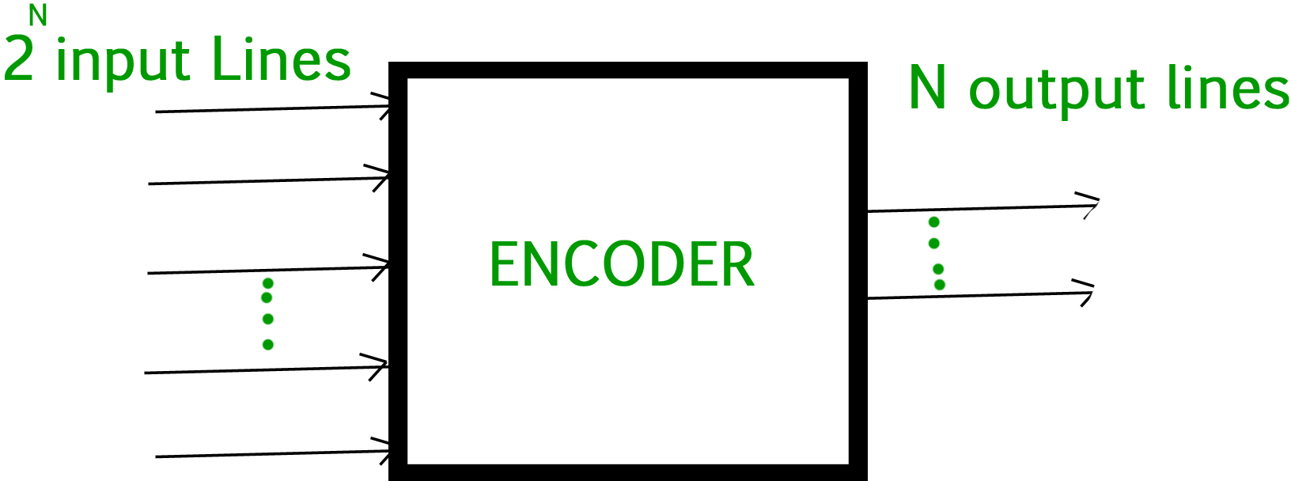
BINARY-ENCODER
An Encoder is a combinational circuit that performs the reverse operation of Decoder.
It has maximum of 2^n input lines and ‘n’ output lines, hence it encodes the information from 2^n inputs into an n-bit code.
It will produce a binary code equivalent to the input, which is active High. Therefore, the encoder encodes 2^n input lines with ‘n’ bits.

Slide 10
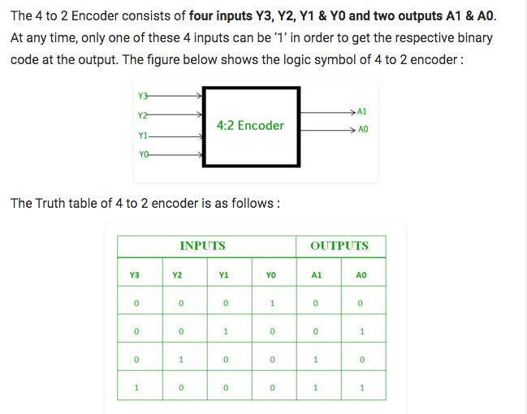

Slide 11
If we record any music in any recorder, such types of process is called
Multiplexing
Encoding
Decoding
Demultiplexing

Slide 12
A decoder converts n inputs to outputs.
n
n2
2n
nn

Slide 13
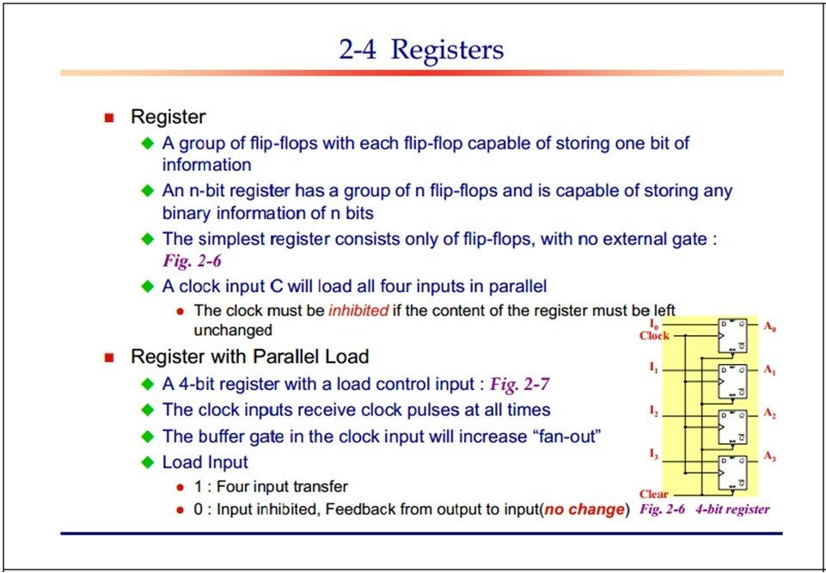

Slide 14
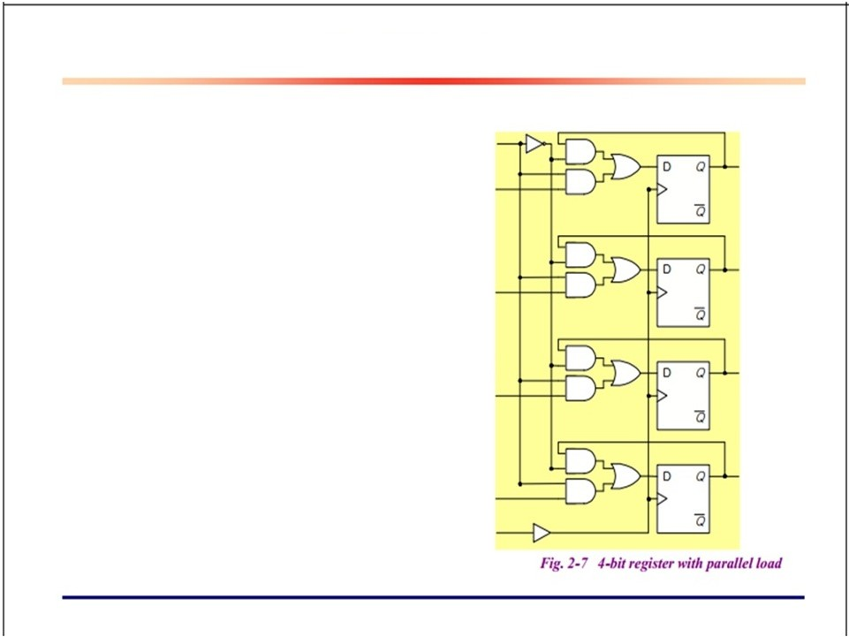

When the load input is 1 , the data in the four inputs are transferred into the register with the next positive transition of a clock pulse
When the load input is 0, the data inputs are inhibited and the D- output of flip flop are connected to their inputs.
14

Slide 15
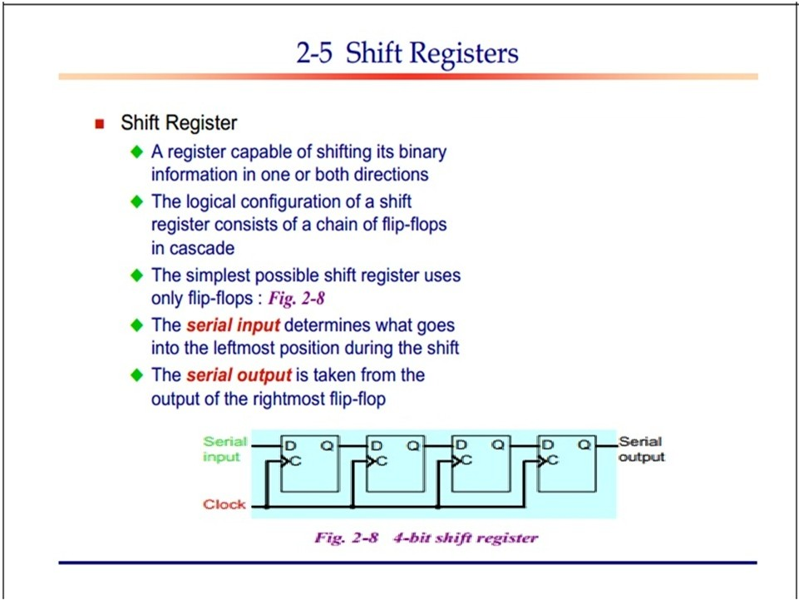

Slide 16
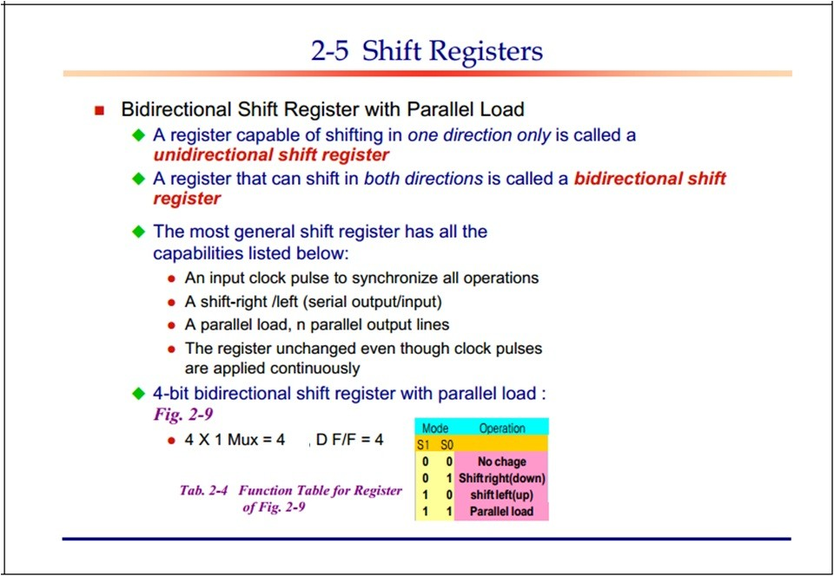

Slide 17
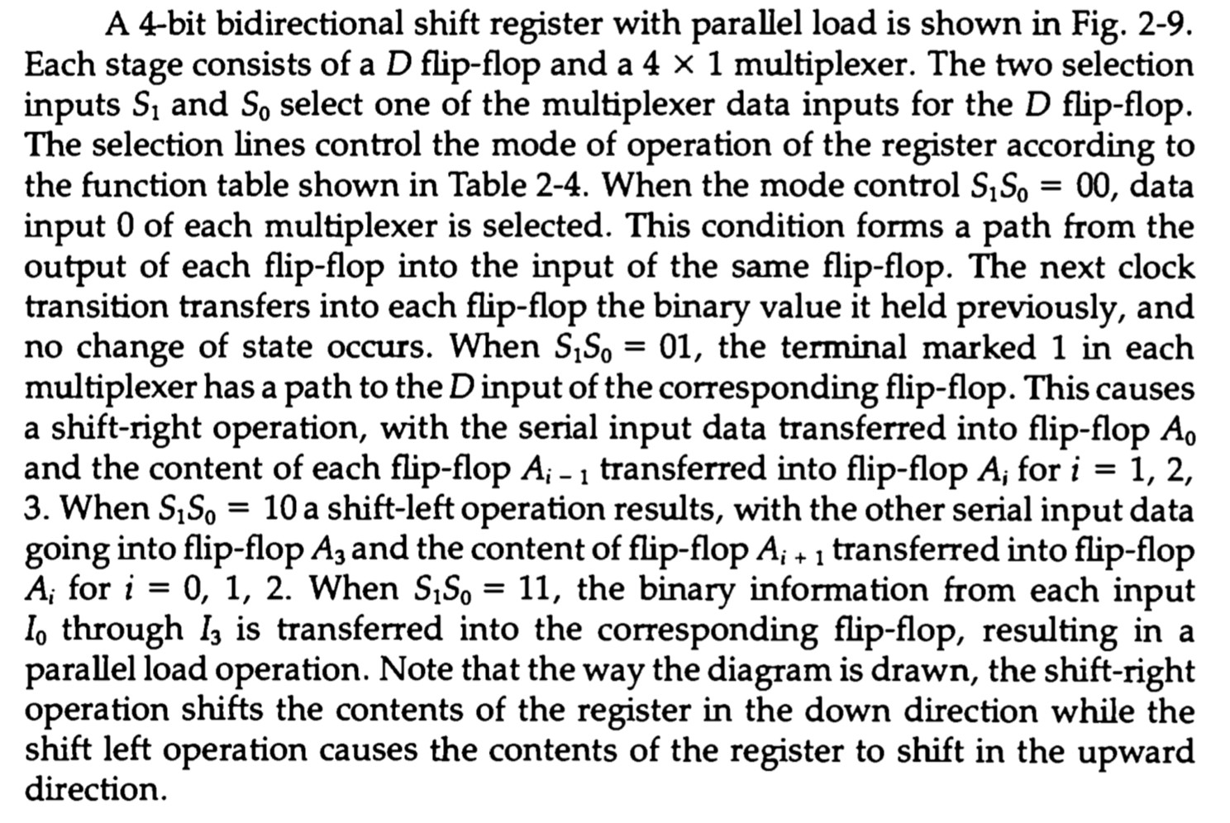

Slide 18
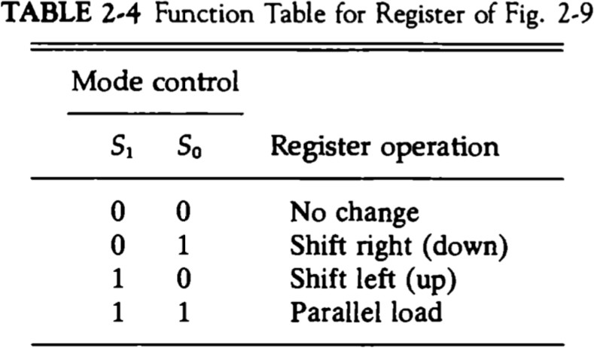

Slide 19
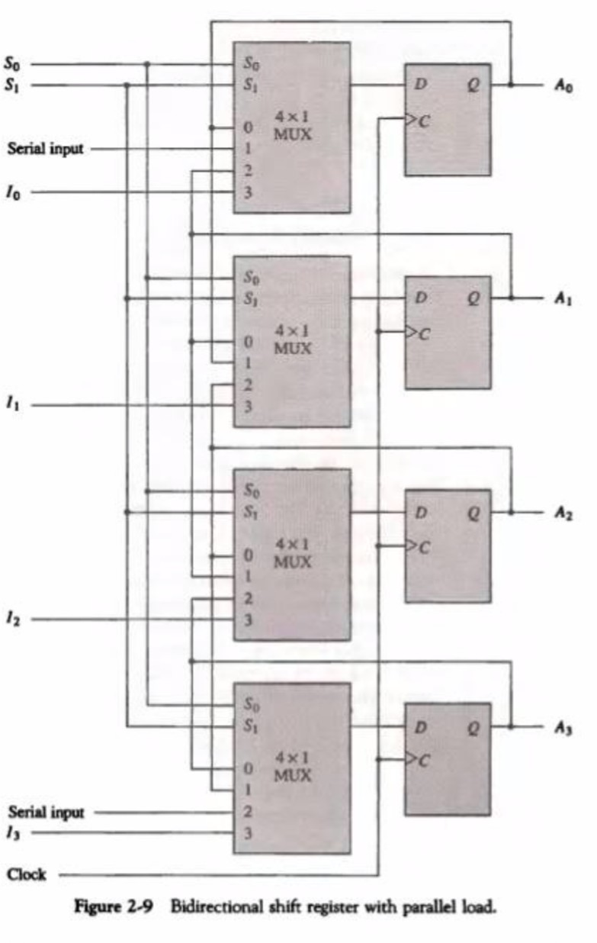

Slide 20
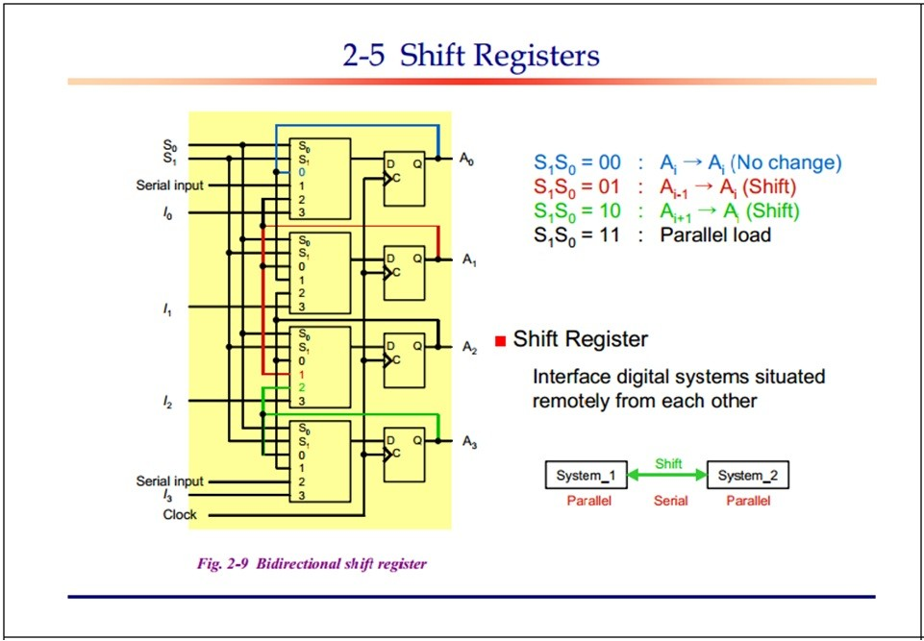

Slide 21
